Slide 1
Full Stack Application Development
Securing API
HTTPS
HTTPS
Akshaya Ganesan

Slide 2
HTTPS

Slide 3
HTTPS
Hypertext Transfer Protocol Secure is a secure version of HTTP.
This protocol enables secure communication between a client (e.g. web browser) and a server (e.g. web server) by using encryption.
HTTPS URLs begin with https instead of http.
HTTPS uses a well-known TCP port 443.
Make sure you always send requests over HTTPS and never ignore invalid certificates.
HTTPS is the only thing protecting requests from being intercepted or modified!!

Slide 4
TLS handshake
HTTPS uses Transport Layer Security (TLS) protocol or its predecessor Secure Sockets Layer (SSL) for encryption.
The TLS handshake enables the TLS client and server to establish the secret keys with which they communicate.
Agree on the version of the protocol to use.
Select cryptographic algorithms.

Slide 5
TLS handshake
Authenticate each other by exchanging and validating digital certificates.
Use asymmetric encryption techniques to generate a shared secret key, which avoids the key distribution problem.
SSL or TLS then uses the shared key for the symmetric encryption of messages, which is faster than asymmetric encryption.

Slide 6
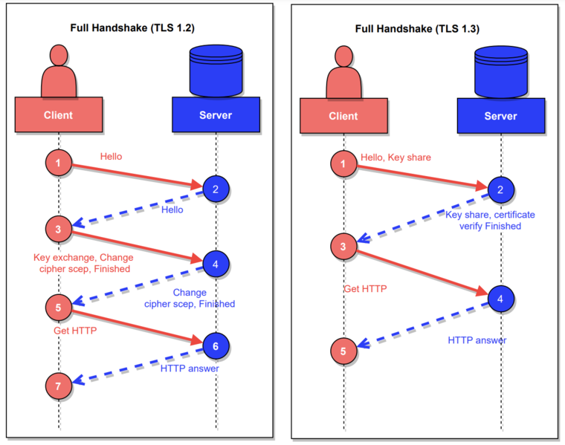
TLS Handshake
Image Ref: https://commons.m.wikimedia.org/wiki/File:Handshake_in_TLS.png

Slide 7
Certificates
The HTTPS protocol is based on the server having a public key certificate, sometimes called an SSL certificate.
When a secure connection is established, the server will send the client its TLS/SSL certificate.
The client will then check the certificate against a trusted Certificate Authority, essentially validating the server’s identity.
A TLS/SSL certificate essentially binds an identity to a pair of keys which are then used by the server to encrypt as well as sign the data.
A Certificate Authority is an entity that issues TLS/SSL or Digital certificates.

Slide 8
HTTPS
HTTPS encrypts those packets, making it extremely difficult for an attacker to get access to the information being transmitted

Slide 9
HTTPS

Slide 10
Thank You!

